Slide 1







END TERM PROJECT
Made by: Nandini Sharma
UID : 2010991951

Slide 2

Acknowledgement
I would want to convey my heartfelt gratiude to Prof. Rafeeq Qureshi, for his invaluable advice and assistance in completing my project. His prescence at every step and his motivating words helped me in accomplishing my task effectively. I’d also like to thank my parents and friends for their support and encouragement which pushed me to complete my project in given time.

Slide 3




Abstract
The ultimate goal of the project is to create an inventory management website which can be a one stop for managing stocks for an organization. Taking advantage of technology can make things easier for an organization and hence inventory management system is invaluable to any retail business. In this project, we are developing a miniature view of inventory management system using ReactJS with scope of scalability. React.js or ReactJS, is an open source JavaScript library for developing web user interfaces. The project also provides back-end features with the help of fakeAPI (JSON-server) and the interaction has been possible because of Axios, which is a promise based client for the browser and node.js. The project also includes an imgae uploader using localStorage for storing files. Hence the crux, front-end is done using React.js, styling using plain CSS and backend is added using json-server and axios.

Slide 4
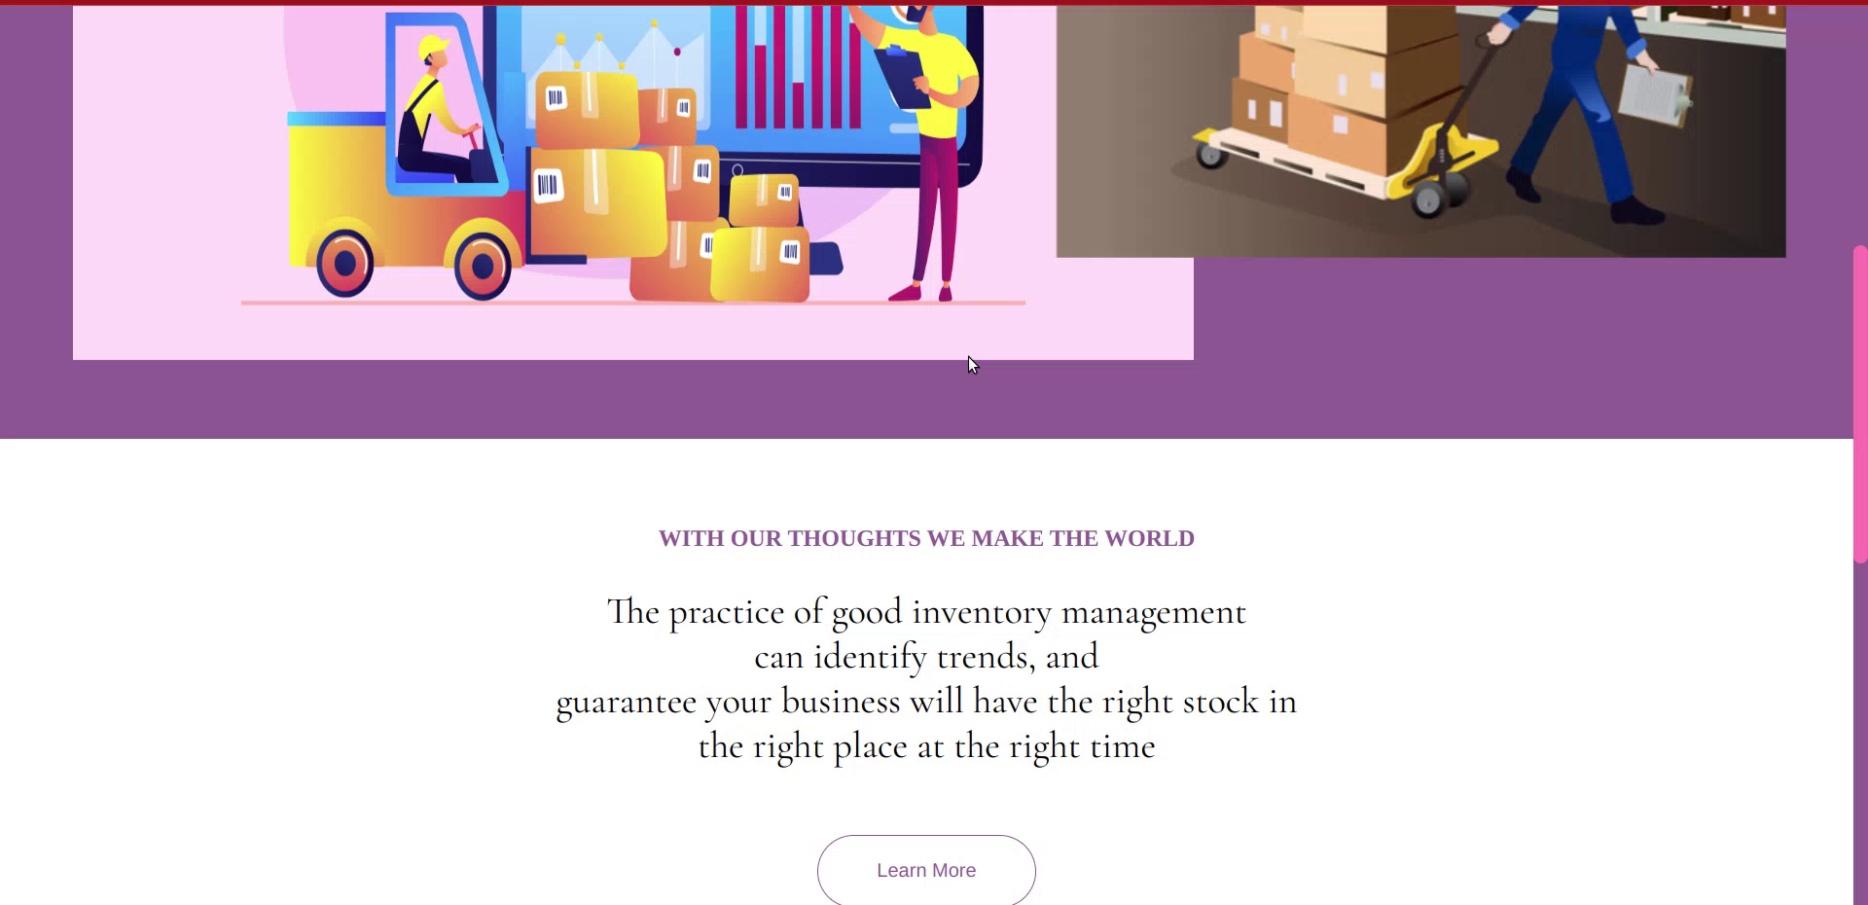
Introduction: Home Page
The page represents introductory page for the website with website logo, navbar and animation added using Animate.css library.
Logo made using Canva
Animation -- Animate.css
Make sure to view the website with 100% zoom only for best results
**Play video given to see the glimpse of home page

Slide 5
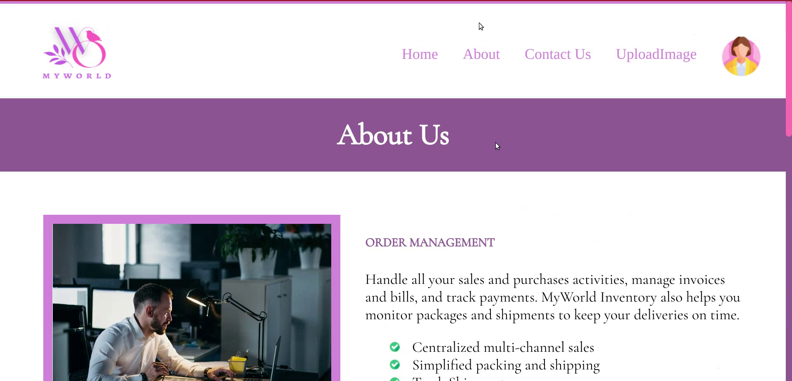
About Page
The about page contains features about my website. Image and paragraph are stacked together side by side using float property under css. Animations are added again using Animate.css

Slide 6
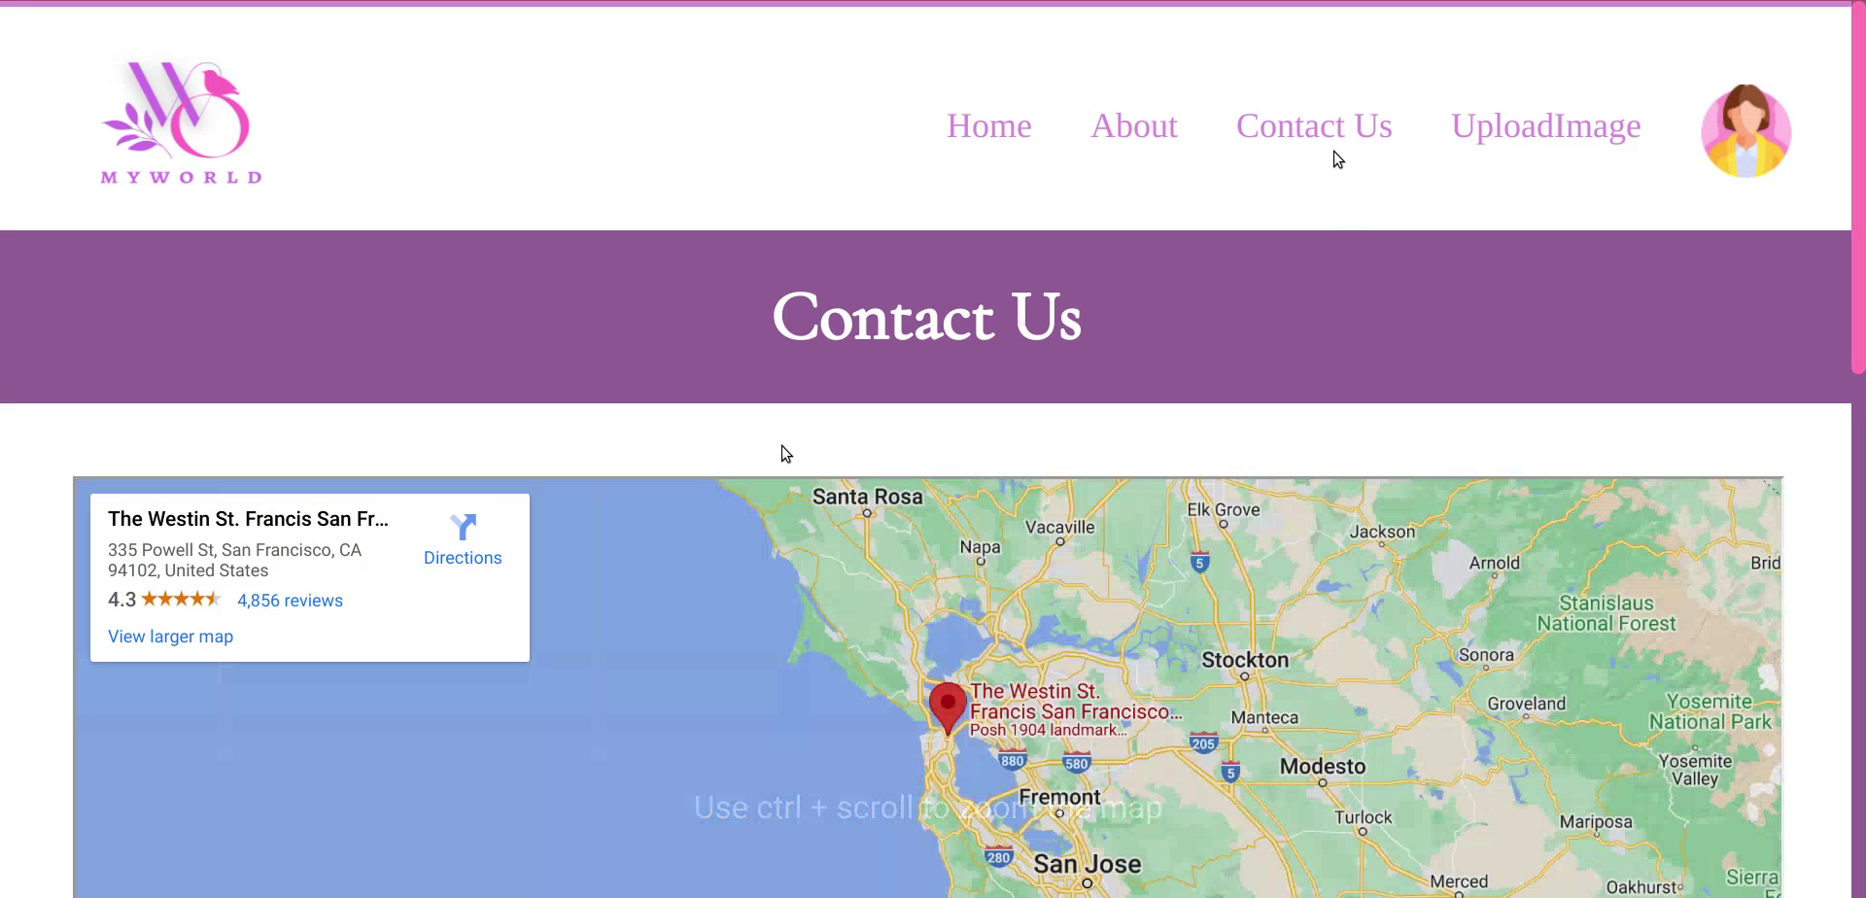
Contact Page
The contact page contains a map with demo address for my company’s location with a form for customers to connect with me.
Map is added using embedded iframe from Google Maps. Form is constructed using basic HTML and CSS.

Slide 7
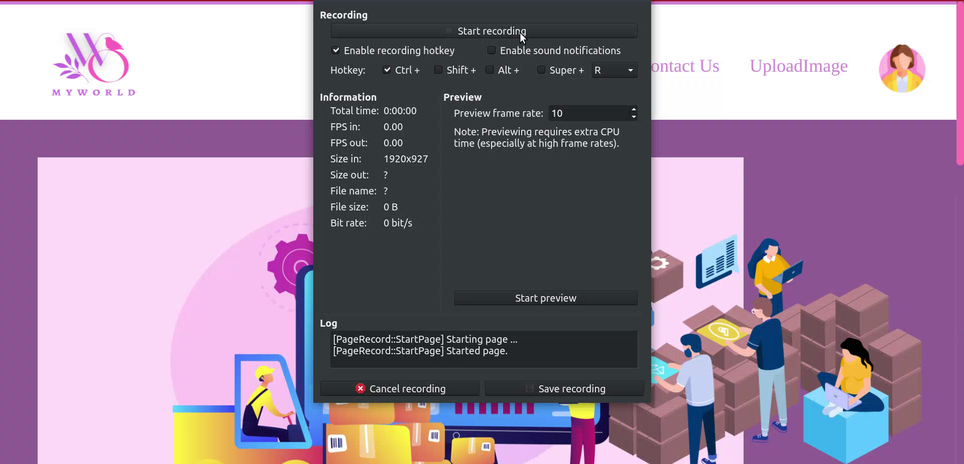
Additional Features
The website also contains a login screen, with username and password fields. It also contains “create new account”, which redirects the user to a register page containing fields name, email, username and password.
For login page, till the time user does not fill the fields, the submit button stays disabled. The form data also contains some validation such as whether account is of admin or other user.

Slide 8
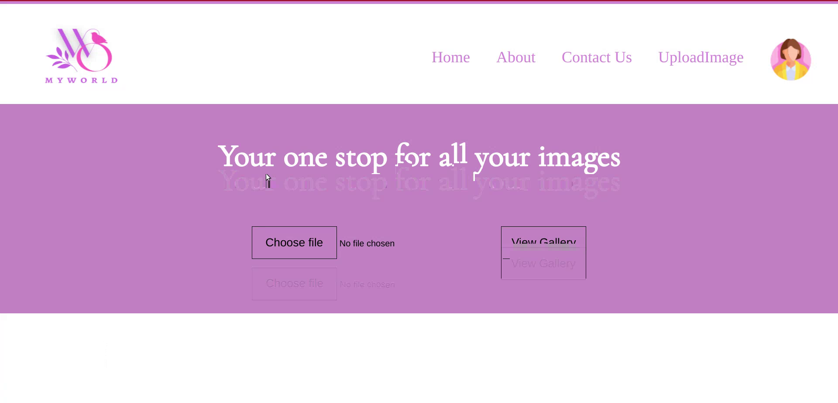
Additional Features (Contd..)
There is a separate page for Image uploading. On clicking “Choose file” button, when one chooses an image, the user can view their selected images by clicking the “View Gallery” button.

Slide 9
Dependencies used
npm start -- for running the react app
cd server and then npm run server -- to start json-server
font-awesome -- for icons
animate.css -- for adding animation
jquery -- used in imageLoader.js
react-router-dom -- for linking various pages using Link, Router and Route
axios -- to fetch data from json-server
json-server -- to create fakeAPI for posting and fetching data

Slide 10

FUTURE SCOPE
The above mentioned project has a lot of scalable factors. For starters, instead of using a fakeAPI with JSON-server and Axios, real backend environment can be used like MongoDB.
Also website can be made more responsive by using CSS frameworks such as Bootstrap and Tailwind.
Also features related to inventory management system can be added like addition of new materials, filtering of data on the bases of different queries, which can be done using DBMS rules.

Slide 11


Bibliography
Search and filter operations:
https://www.freecodecamp.org/news/search-and-filter-component-in-reactjs/
CRUD operations:
https://www.freecodecamp.org/news/how-to-perform-crud-operations-using-react/
Image Loader:
https://catalins.tech/store-array-in-localstorage
https://www.surinderbhomra.com/Blog/2022/04/14/Storing-An-Array-of-Images-In-localStorage#:~:text=Update%20local%20storage.-,localStorage.,)%20%7B%20const%20localStorageData%20%3D%20localStorage.
website idea:
https://mariela.webflow.io/

